Slide 1
Installation Guide
(LiveCycle Data Services 2.61)
2008. 12. 10
CODELABOR

Slide 2
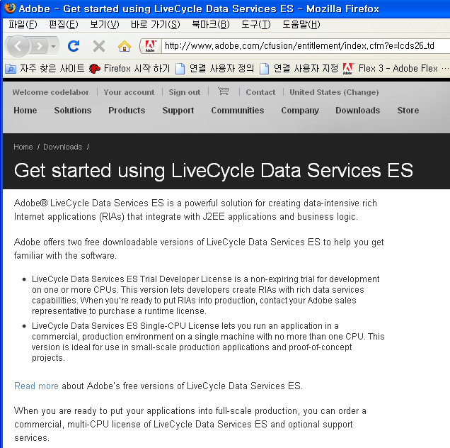
LiveCycle Data Services ES
Installation
Download Site URL: http://www.adobe.com/cfusion/entitlement/index.cfm?e=lcds26_td
Download File: lcds261-win.exe

Slide 3
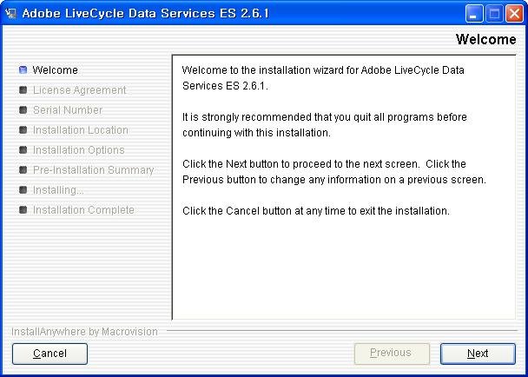
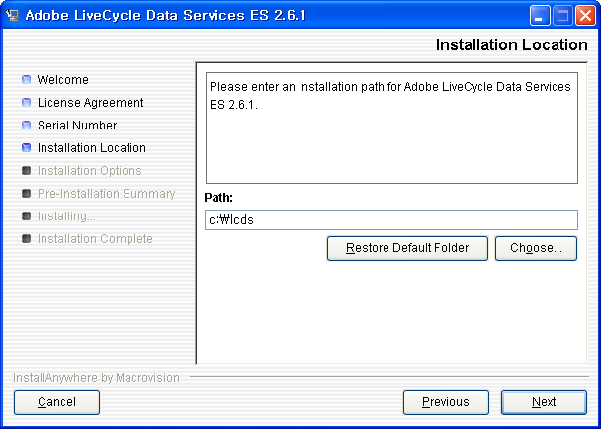
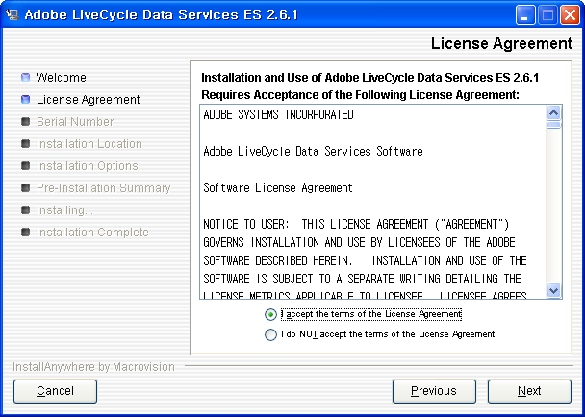
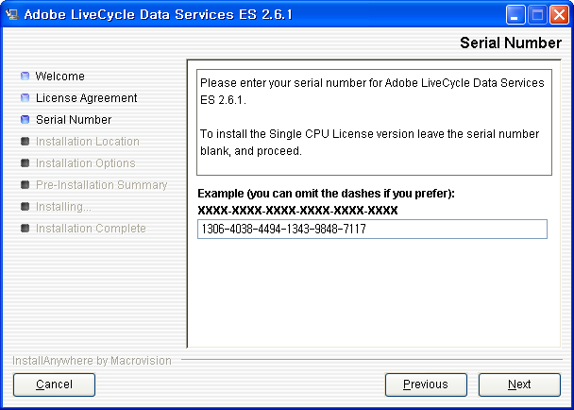
LiveCycle Data Services ES
Installation
Path: C:\lcds
Trial Number: 1306-4038-4494-1343-9848-7117

Slide 4
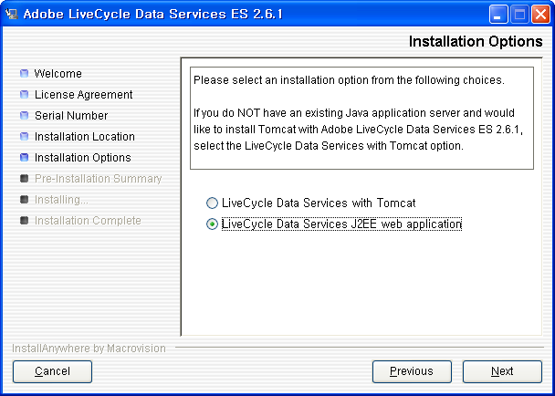
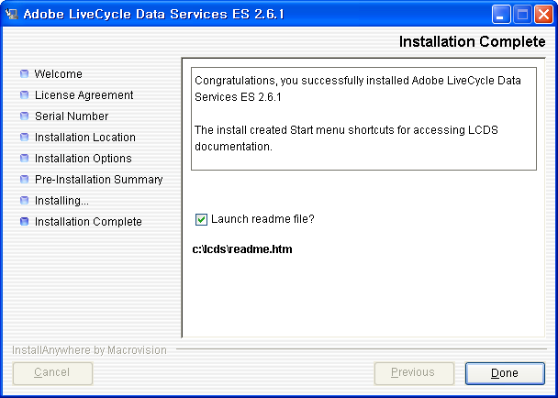
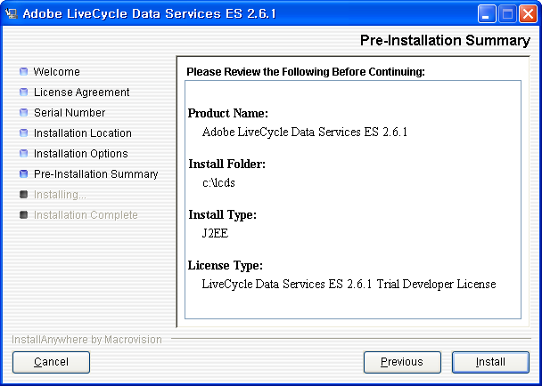
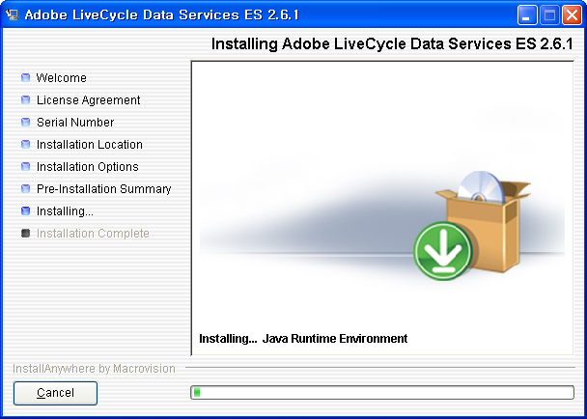
LiveCycle Data Services ES
Installation
Check LiveCycle Data Services J2EE web applications

